Slide 1
Zooey Deschanel
By: Jashley Aleman

Slide 2
Why?
~I picked Zooey Deschanel because she is a talented actress and her roles are very well executed.
~She is an energetic person and always has a smile on her face.
~ I also picked her because she is a hilarious person who makes people laugh with her roles and in real life.

Slide 3
Background
~Zooey was born January 17,1980 in Los Angeles, California.
~Her full name is Zooey Claire Deschanel.
~Her hometown is Los Angeles, California.
~Her monthly salary is 95,000 for starring in a Fox sitcom. She’s listed $1,578,000 in the bank,$1,645,000 in stocks, and $693,300 in property. Her total net worth would be $3,916,300.
~She was named after a male character in J.D Salinger’s “Franny and Zooey.”

Slide 4
Background
~She is the lead singer of a band called “She and Him.”
~She has 2 kids Elsie Otter Pechenik and Charlie Wolf Pechenik.
~She has been acting since 1998 when she was just 18 .

Slide 5
Education
~Zooey Deschanel went to Crossroads School in Santa Monica, California. Crossroads is a school for arts and sciences, it is a private K-12 school.
~Zooey went to the Northwestern University in Evanston, Illinois for one year, but dropped out.
~She spent several summers at a camp upstate in New York at French Woods Festival of the Performing Arts.

Slide 6
Education Pictures
Crossroads school in Santa Monica, California
Northwest University in Evanston, Illinois

Slide 7
Career
~In 1999 she was in a movie called “Bridge to Terabithia” and she played the role of Ms. Edmunds.
~In 2008-2013 Zooey was in the series “The Simpsons” and her characters name was Mary Spuckler.
~She was recently in the movie “Trolls” and she is the voice of Bridget.

Slide 8
Career
Zooey Deschanel is a successful actress rising. She has a successful career in acting and she has played many characters. These are some examples of some of her roles.
~ She stars in a series called “New Girl” Zooey plays the main character and female lead Jessica Day.
~She was also in the movie “Elf” she played the role of Jovie.
~Zooey was also in the romantic movie “Failure to Launch” where she played the role of Kit.

Slide 9
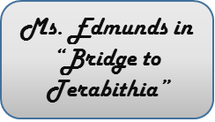
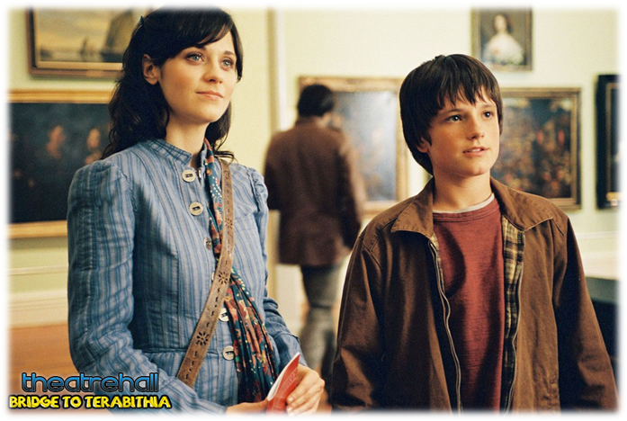
Career Pictures
Jovie in “Elf”
Mary Spuckler in “The Simpsons”
Fox show “New Girl”

Slide 10
Most Known For
~She is most known for her role as Jessica Day in the Fox sitcom “New Girl.”
~She played the part of Jovie on the movie “Elf.”
~ She played the lead role in “500 Days of Summer” as Summer.

Slide 11
Awards/Recognitions
~She was nominated for Favorite Actress 3 times in 2011,2012,2013 and won in 2012.
~She was also nominated 3 times for Best Actress in a Comedy, Series, or Musical.
~Zooey was nominated for Best Actress in a Comedy Series 2 times and won in 2012.
~She has been nominated 35 times for awards and has won only 7 times.
~She has been nominated for 3 Golden Globes, 1 Emmy, 1 Grammy, 4 People’s Choice Awards, 2 Teen Choice Awards and many more.

Slide 12
What I Learned
~I learned that she is as funny and sweet outside the cameras and sets as she is inside the cameras acting.
~Something that I didn’t know about her was that she is the lead singer in a band.
~She sang the national anthem in 2011 in the Game 4 World Series.
~She was bullied in middle school, she said in an interview that girls would spit in her face.

Slide 13
Work Cited
http://www.imdb.com/name/nm0221046
~
~
~http://www.tv.com/people/zooey-deschanel/
http://www.tvguide.com/celebrities/zooey-deschanel/credits/179908/

